Slide 1
Guidance document for uploading training documents

Slide 2
What’s new
Training documents will now be maintained online on Cognizant LMS
Documents used prior to 10th Sep 2019 | Documents to be used post 10th Sep 2019
Curriculum Vitae (hard copy) | Curriculum Vitae (online)
Role Description (hard copy) | Project Role Description (read and understand on LMS)
Global Training Plan (hard copy) | Project Global Training Plan (need not be printed)
Transcripts (hard copy) | Transcripts (need not be printed)
Manager’s review of training records (hard copy) | Manager review to be confirmed on Cognizant LEARN
OJT and TTT related documents (hard copy) | OJC and TTT documentation (on mail and saved on shared repository)

Slide 3
Table of Contents
Key abbreviations and definitions
Guidelines for training file review
General guidelines for training documentation
Steps to upload and approve CV
Creation of course code for PRD (For Project Managers)
Read and understand PRD (For Associates)
Creation of Project Global Training Plan (For Project Managers)
Completion of Trainings (For Associates)
How to log a self-reported training (For Associates)
Use Emulate profile (For Line Managers)
Steps to Initiate and approve Manager review workflow
Notes:
Reduce the paper work
Update training documents anytime, anywhere
Ease of tracking training documentation compliance
Be audit ready

Slide 4
Key abbreviations and definitions
Abbreviation/Term | Definition
PRD (Project Role Description) | PRD documents roles and responsibilities specific to project; based on the scope of work defined by the Client.
PGTP (Project Global Training Plan) | PGTP is a list of Cognizant and client trainings defined for each project/engagement within LS DO. The Cognizant section of the project GTP shall be derived from the MGTP. Project specific trainings identified for the specific roles may be incorporated in consultation with the client
CRD (Cognizant Role Document) | Documents the roles and responsibilities as per Cognizant Career Architecture framework. This document/equivalent is to be used in absence of Project Role Document example: for support functions
OJC | On Job Coaching

Slide 5
General Guidelines
Following training records will be maintained on Cognizant LMS
Cognizant/Project CV (if applicable)
Project Role Description (PRD)
Use standard templates available in Process Space (Quality Management System) for creating the training records
Process Space link: https://deliveryexcellence.cognizant.com/apps/processspace
Paper training records shall be maintained in the projects wherever mandated by the clients as per the ‘SWI for maintenance of documents’. Legacy paper training records (created before 10th Sep 2019) shall be archived in accordance with the ‘SWI for Archives (Maintenance)’ and ‘SWI for Archives (Indexing, Filing and Retrieval)
Note: In absence of PRD, use Cognizant Role Document/equivalent provided by Talent Manager/Function Head

Slide 6
General Guidelines
Project manager/designee shall maintain the following dates centrally for audit/inspection purpose:
Associate’s project joining date
Role assigned date
Role change date (if applicable)
Exit date
For a new associate joining the project, the two dates shall be the same and for an associate taking up a new role or project change, project joining date shall differ from the Cognizant joining date

Slide 7
Process to upload and approve CV in Cognizant LEARN

Slide 8
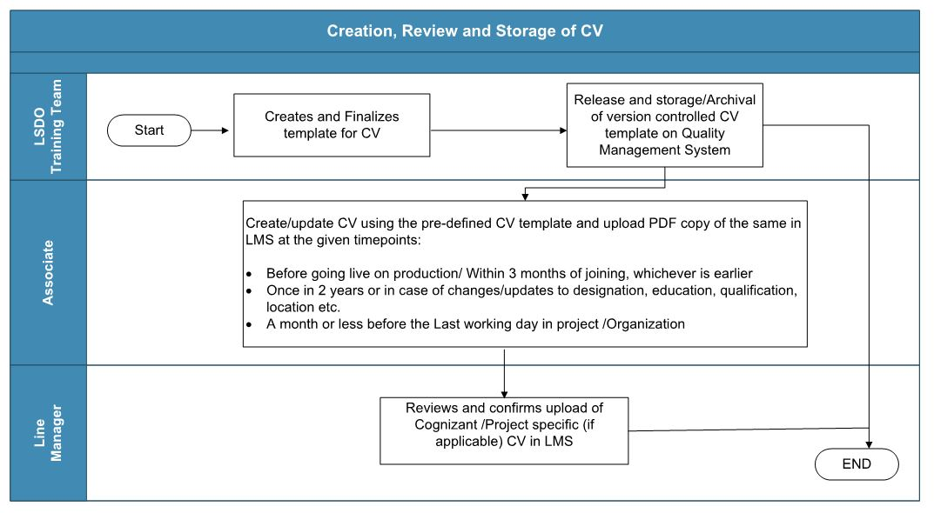
Process flow for Creation, Review and Storage of CV

Slide 9
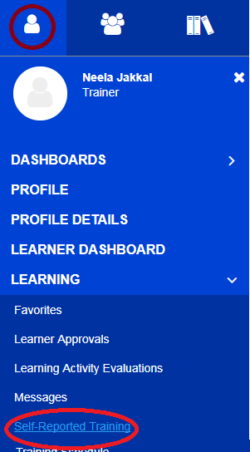
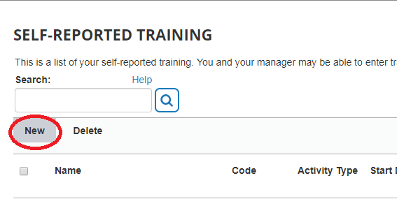
Uploading CV (For Associates)
1
Login to LEARN and click on self-reported training as shown
2
Click on New to upload PDF copy of CV

Slide 10
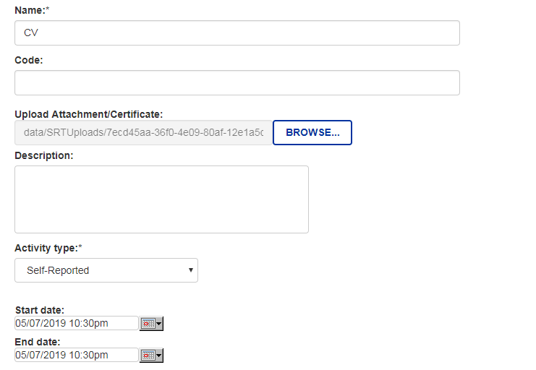
3
Enter details and upload CV as shown
Name should be CV as seen in the screenshot
Keep it blank
Upload your last updated PDF copy of CV here
Keep it blank
Select the type as self-reported from drop down
Start dates and end dates can be the same as that of the date when CV was last updated

Slide 11
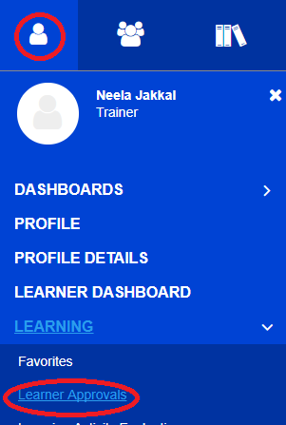
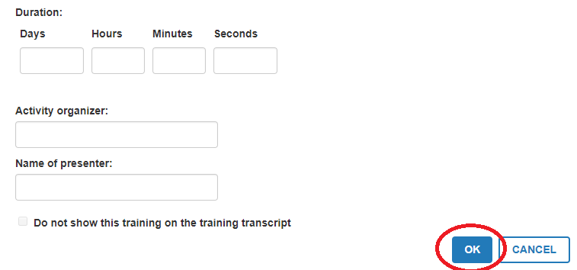
4
Click on OK to submit the record for your manager’s approval
5
Managers to approve the record by following the below path. Click on Learner Approvals
Activity organizer, duration, name of presenter fields to be left blank

Slide 12
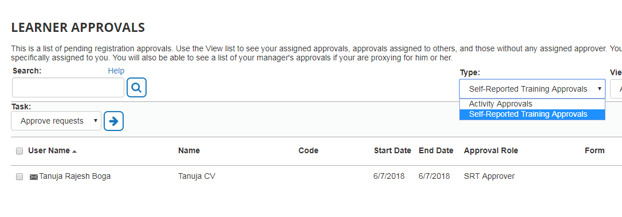
Manager approval process
1
3
2
Click on self reported training approvals to display the request.
Select the associate’s name whose record needs to be approved by selecting the checkbox besides name.
Click on Approve requests by selecting the arrow besides the task

Slide 13
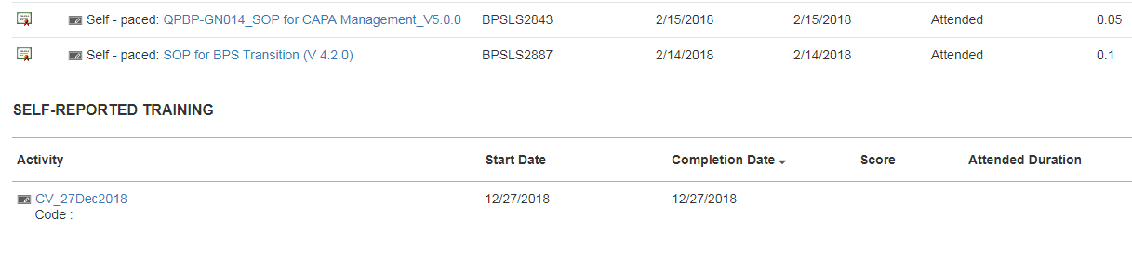
Once the record is approved check the transcript page in LEARN to see if it reflects the approved record.

Slide 14
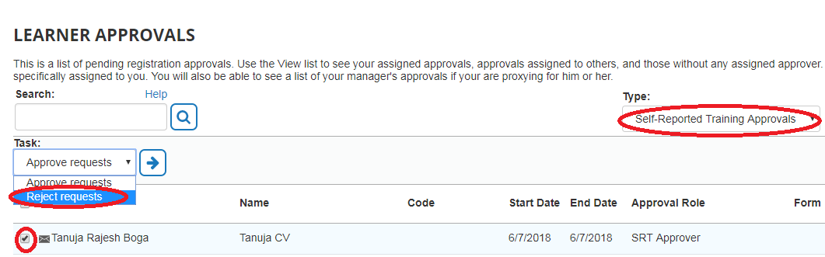
Manager approval process (How to reject an erroneous record)
If the CV document uploaded has errors, line managers can reject the request
1
3
2
Click on self reported training approvals to display the request.
Select the associate’s name whose record needs to be rejected by selecting the checkbox besides name.
Click on Reject requests by selecting the arrow besides the task

Slide 15
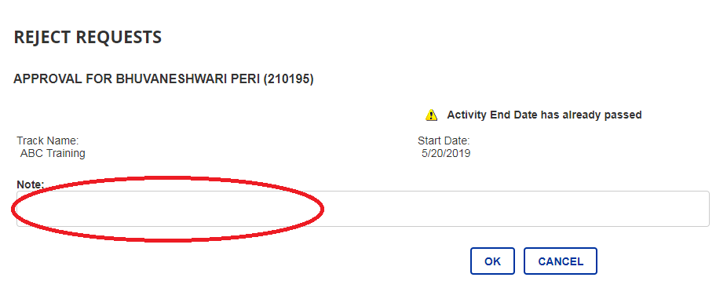
Manager process (How to reject an erroneous record)
Provide rejection comments in the Note section and click on OK

Slide 16
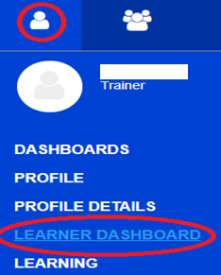
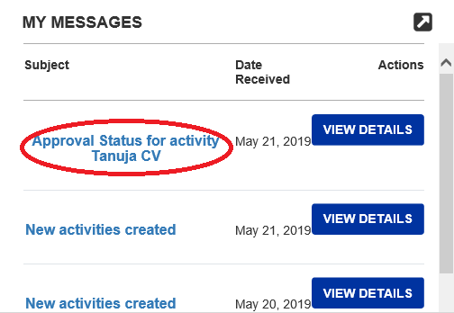
How to view rejected record (For Associates)
Rejection comments and records can be checked from the My messages section of the Learner Dashboard page.

Slide 17
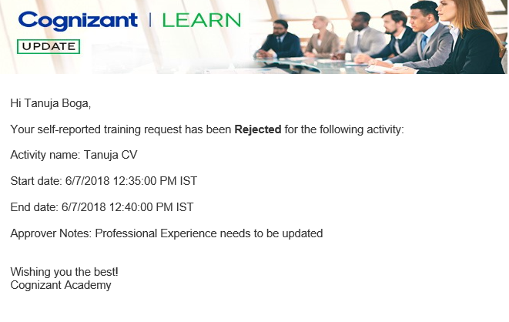
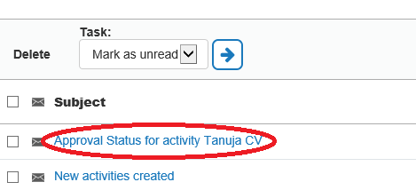
How to view rejected record (For Associates)
Approver notes can be viewed by clicking on the message. A copy of this message will also be sent via mail to the user.
Note: Associates need to upload corrected/updated CV once the record has been rejected

Slide 18
FAQ for CV’s
Use template from Process Space to prepare Cognizant CV
For project CV, use template given by client, if any
Line Managers or associates can themselves download the CV from LEARN if asked during audits/inspections
LMS admin should be contacted to retrieve CV’s of associates who have left the organization
New joiners should update CV within 3 months of joining or completion of required trainings, whichever is earlier
All tenured associates to update CV once in 2 years or whenever there is a change in the designation, educational qualification or location
CV should be updated a month or less before last working day in project/organization

Slide 19
Project Role Description

Slide 20
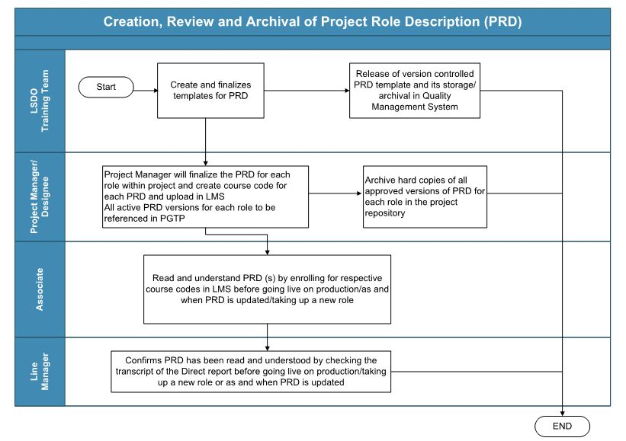
Creation, Review and Archival of PRD

Slide 21
Upload Project Role Description Document (for Project Managers)
PRDs to be uploaded on Cognizant LEARN, only if agreed with the client
Hard copy PRD needs to approved and wet-ink signed by the author, reviewer and approver
Upload PRD for every role within the project as a separate course code
Naming convention to be followed:
PRD_Role Name_Project name_Version_effective date of PRD
Project Manager/designee to complete course code requisition template and send the PRD for upload to LMS admin team and LS DO training team
Each time the PRD is updated, the new version shall be uploaded in Cognizant LEARN by updating the course name to reflect the new version and effective date
All current versions of PRD for all roles should be referenced in the PGTP.

Slide 22
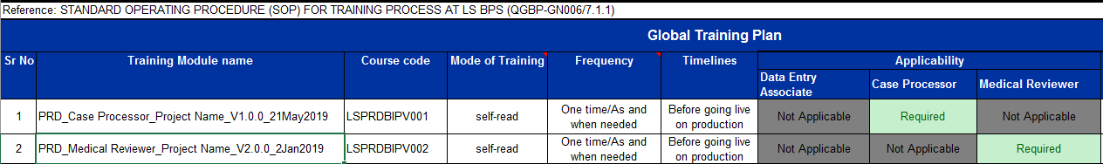
How to document PRD course codes in PGTP (For Project Managers)
All the course codes should be referenced in the PGTP as shown below

Slide 23
Read and Understand Project Role Description Document (for Associates)
Refer PGTP and register for PRD course code in Cognizant LEARN as per assigned role
Read and Understand the PRD on Cognizant LEARN and check the transcript for the PRD record
In case of multiple roles, enroll and complete all applicable PRD course codes.

Slide 24
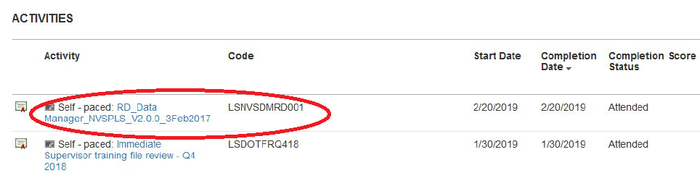
Read and Understand Project Role Description Document (for Associates)
Refer PGTP and register for PRD course code in Cognizant LEARN as per assigned role
Read and Understand the PRD on Cognizant LEARN and check the transcript for the PRD record
In case of multiple roles, enroll and complete all applicable PRD course codes

Slide 25
Project Global Training Plan

Slide 26
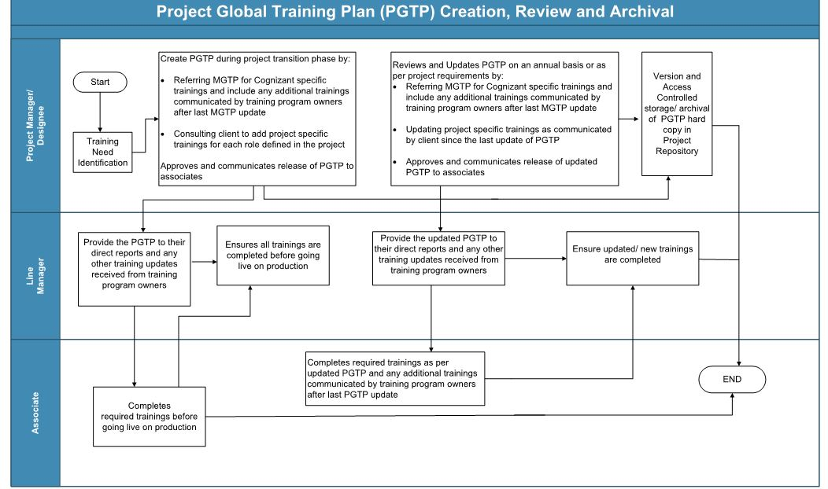
PGTP creation, review and archival

Slide 27
Project Global Training Plan (for Project Managers)
The PGTP shall be reviewed and updated as per the project requirements, or on an annual basis at a minimum
Adhoc/refresher trainings need not be incorporated during PGTP update process, but should be documented on LMS as and when conducted

Slide 28
Completion of Trainings (For Associates)
Associates will refer only the PGTP kept on project repository to complete trainings on Cognizant LEARN
Following trainings will be auto-assigned to all LS DO associates on Cognizant LEARN using LS department ID as the identifier
LS regulatory trainings
LS Mandatory trainings
Cognizant Procedures (Corporate level and LS DO level procedures)
Line Managers will ensure tagging of their associates to LS Department ID. In case of incorrect tagging, contact Talent Supply chain SS team to initiate correction
Cognizant Domain SOP’s, Therapeutic area trainings to be completed by self-registering for these trainings in Cognizant LEARN
In absence of client LMS, associates will record project specific trainings (if agreed with the client) on Cognizant LMS as self-reported training. Project training transcription logs have been decommissioned.
Line Managers to ensure associates complete mandated trainings before going live on production

Slide 29
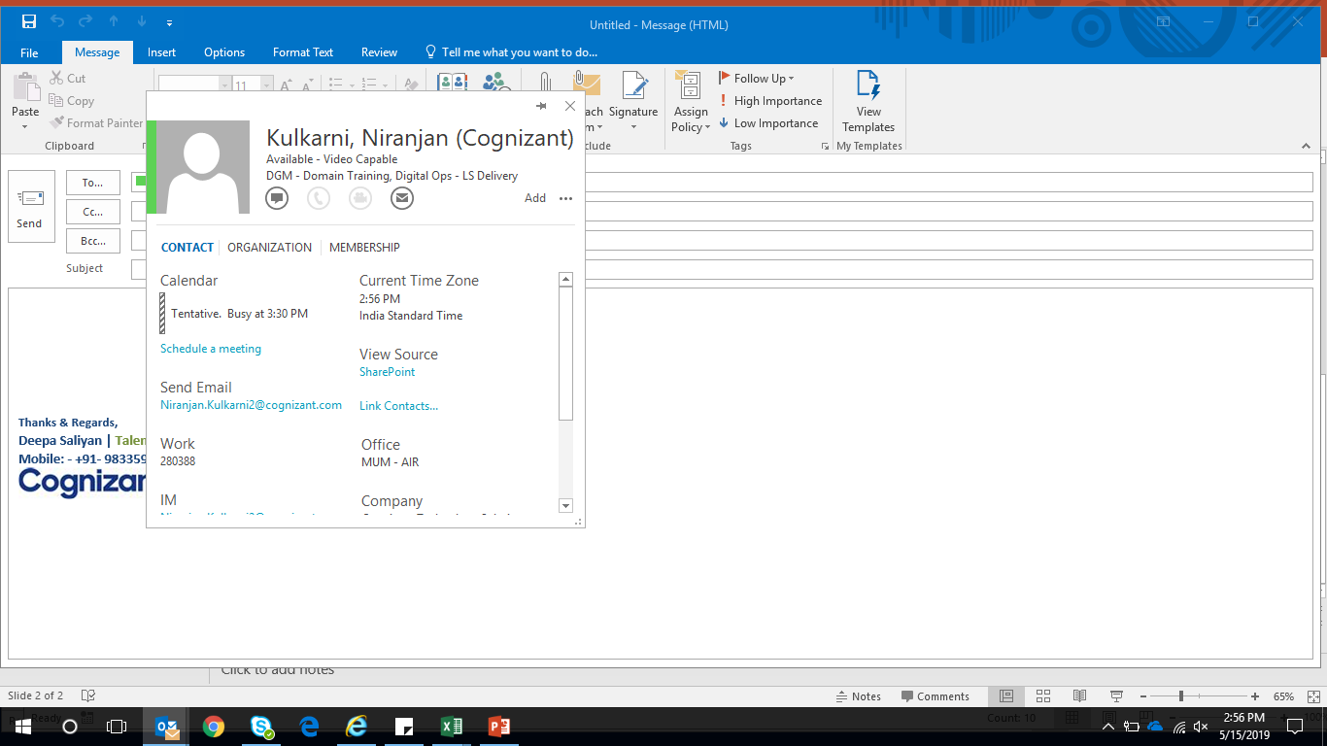
Process to correct Department ID (For supervisors)
Supervisor can click on the employee ID in Outlook and check the Department that is tagged for the associate (circled in red).
If it appears to be incorrect (CDO-Cognizant Digital Operations), the supervisor can fill in the below template and send it to the SS team (GWFMSS@cognizant.com) and TSC POC
Should reflect as Digital Ops – LS Delivery
Template for Department transfer
Associate ID | Associate Name | Current Department | Current Dept ID | Location | New ID | New Dept | Supervisor id | Supervisor Name | Effective Date
123456 | James Smith | Cognizant Digital Operations | BP00001 | Mumbai | SBP0008 | Digital Ops - LS Delivery | 567891 | Alexander

Slide 30
How to log self-reported training (For Associates)
1
Login to LEARN and click on self-reported training as shown
2
Click on New to report a new training

Slide 31
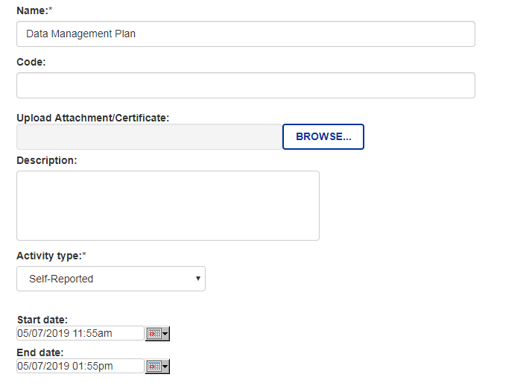
How to log self-reported training (For Associates)
Mention Training Name
This field can be kept blank
This field can be kept blank
This field is optional. You can enter course description
Select self-reported from drop down
Enter Training start date
Enter Training stop date

Slide 32
FAQ’s on Transcripts and Self – reported training
Transcripts to be printed only on need basis (ex: if requested during audits and inspections)
Transcripts from Cognizant LEARN and EMERGE to be maintained in respective systems and Client transcripts to be maintained in client LMS

Slide 33
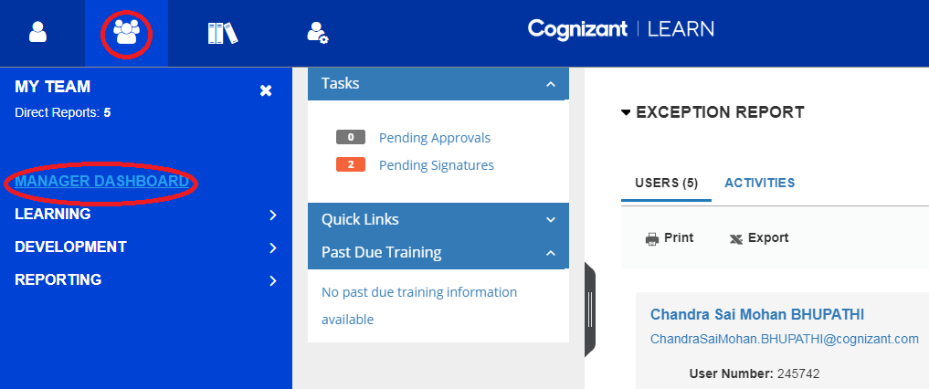
How to check completion of trainings (For Line Managers)
Line Managers can check their direct reports training completion using the Emulate Profile feature of Cognizant LEARN
1
Click on My team icon. Navigate to Manager dashboard to access the profile of your direct reports

Slide 34
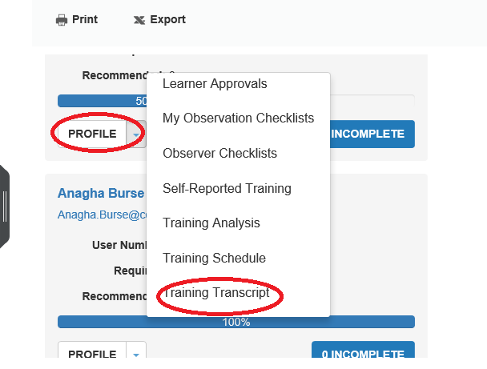
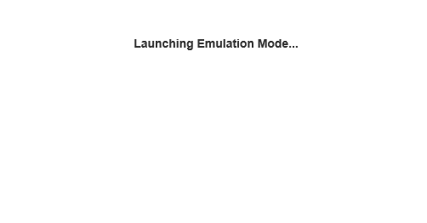
How to check completion of trainings (For Line Managers)
Click on the dropdown button besides Profile below your direct report’s name to enable the emulate feature
Click on any one of the pages that you wish to view, to switch on the Emulate mode. Once the Emulate mode is launched the following screen will be displayed
2
3

Slide 35
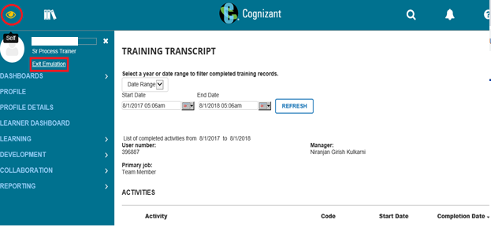
How to check completion of trainings (For Line Managers)
The eye icon (circled in red) refers to the emulate icon mode. Managers can access Learner dashboard page, Training Analysis, Training transcript, self- reported training and Training Schedule pages

Slide 36
Initiate Manager Review workflow (For Associates)
Manager review will be conducted:
Before associates going live on production or completion of the required trainings, whichever is earlier
Approximately every 6 months thereafter at the end of Q2 and Q4 of the calendar year
Before the associate’s last working day in the project/organization
Review will be completed on Cognizant LEARN using course codes referenced in PGTP for all the above mentioned timelines
Note: MGTP to be referred if codes are not available in PGTP
Associates will enroll for any one of the below given manager review course codes as per the applicable timeline
Course name | Course code
Six monthly review of training records | LSDOTRFSIXMNTH001
New joiner training file review | LSDOTFRPRD001
Last working day review of training records | LSDOTFRLWD001

Slide 37
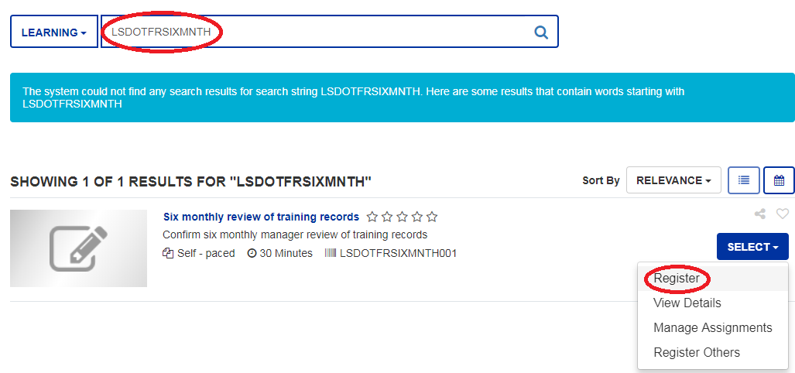
Initiate Manager Review workflow (For Associates)
Enroll for the course LSDOTFRSIXMNTH001

Slide 38
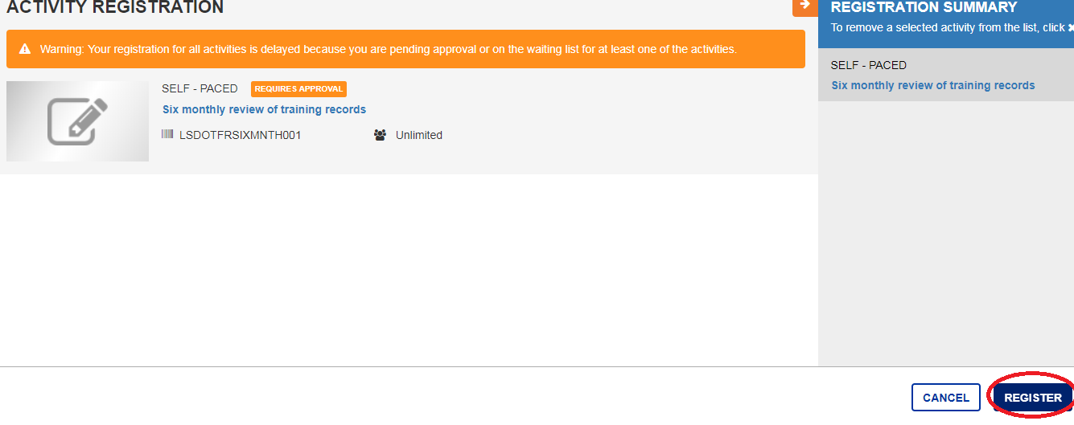
Click on Register to initiate the registration process

Slide 39
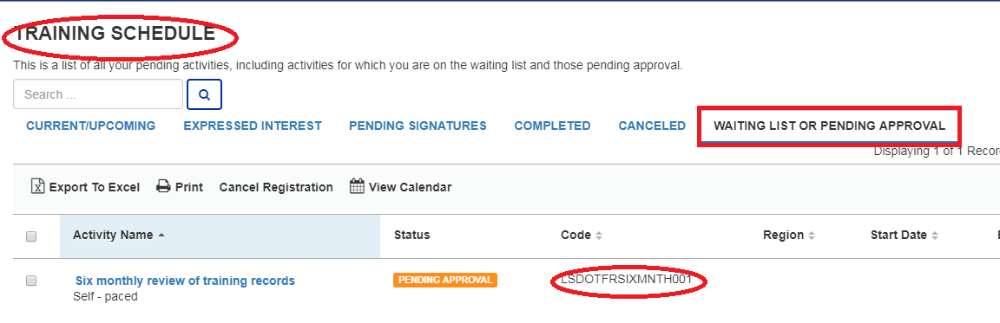
Navigate to the Training Schedule page of LEARN. Training should reflect under pending approval list

Slide 40
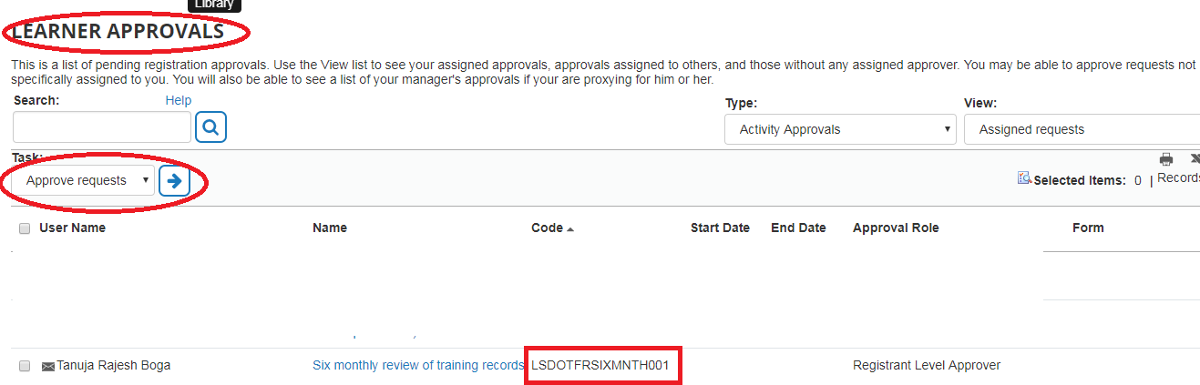
Manager approval workflow
Navigate to Self > Learning > Learner Approvals page. Select your reportee name and click on the arrow besides approve requests as shown in the screenshot below

Slide 41
Manager approval workflow
Do not reject the requests, provide comments in the Note section if discrepancies are observed in any of the training records. This is done to maintain an audit trail of approvals.
Associates to re-enroll for the Manager review in Cognizant LEARN in case any discrepancies are observed.
Managers to approve the workflow only after the comments have been resolved by their direct report

Slide 42
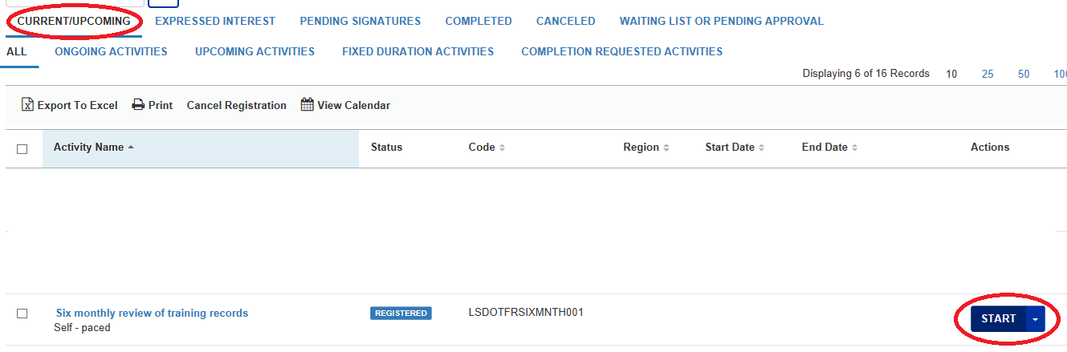
Completion of workflow (For associates)
After manager’s approval associate to login in LEARN again and navigate to the Training Schedule page of LEARN. Under Current/upcoming activities you will find the course on Six monthly review of Training records. Click on the start button to launch the training

Slide 43
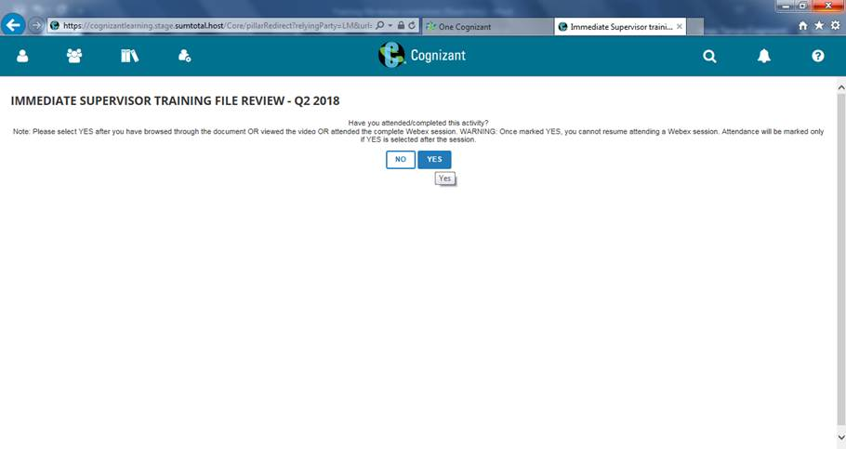
Completion of workflow (For associates)
An instruction document will open upon clicking on the start button Please go through the same and then close the document. Below screen will pop up on closing the document . Click on Yes to complete the training

Slide 44
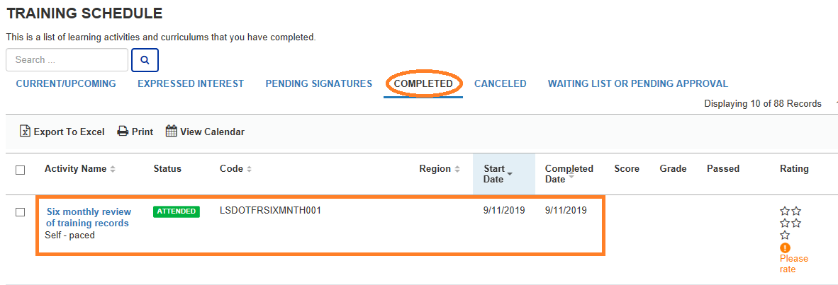
Completion of workflow (For associates)
Completed training should now reflect under Completed tab of training schedule page as shown above as well as the training transcript

Slide 45
Guidance for Training File Review
Documents | Guidance
CV | Upload the latest CV in the current template before the manager review
PRD | Read and Understand PRD for the current role/s on LMS irrespective of the availability of last signed copy/ies in training file
Project training transcription log | Project trainings read through client share point/repository to be logged as self-reported training in Cognizant LEARN after 10th Sep 2019, irrespective of when they were completed. Naming convention of the trainings should match the PGTP
Manager review of training records | Q2 Manager’s review should be completed before 10th Sep on paper log. Manager review for Q4 will be completed only on LEARN.
PGTP/Transcript/Certificates | Need not be printed
On Job Coaching Certification (process will be applicable once the SWI on OJC becomes effective) | OJC documentation will be sent to mentee and a PDF Copy of the same to be saved in Project repository by Mentor
Train the Trainer certification (process will be applicable once the SWI on TTT becomes effective) | Certifying trainer/POC to maintain the TTT documentation on a central repository
Note: Managers will review the paper documents from the last review to ensure all the documents are updated

Slide 46
Thank you

